Slide 1


asymmetric encryption
Vraj Shah

Slide 2

What is Encryption?
“The process of converting information or data into a code, especially to prevent unauthorized access.” [1]

Slide 3

How Does Encryption Work?
Cryptographic Key
A string of characters used within an encryption algorithm for altering data so that it appears random. [3]

Slide 4
Symmetric Encryption
Asymmetric Encryption

Slide 5
Symmetric Encryption

Slide 6


Alice
Bob

Slide 7

Alice
Bob
Sensitive Document

Slide 8

Alice
Bob
Sensitive Document

Slide 9

Alice
Bob
Sensitive Document

Slide 10

Alice
Bob
Sensitive Document

Slide 11
Alice
Bob
Sensitive Document

Slide 12
Symmetric Encryption

Slide 13
Symmetric Encryption
Asymmetric Encryption

Slide 14
Asymmetric Encryption

Slide 15




Alice
Bob
Private Key
Private Key
Public Key
Public Key
Public Key
Public Key

Slide 16
Alice
Bob
Private Key
Private Key
Public Key
Public Key
Bob’s
Public Key
Alice’s Public Key

Slide 17
Alice
Bob
Sensitive Document
Bob’s
Public Key

Slide 18
Alice
Bob
Encrypted with Bob’s public key

Slide 19
Alice
Bob
Encrypted with Bob’s public key
Bob’s
Private Key

Slide 20
Encryption
Symmetric Encryption
Asymmetric Encryption
1 Key
Faster
Less Secure
Algorithms [3]
AES
3-DES
SNOW
2 Keys
Slower
More Secure
Algorithms [3]
RSA
Elliptic curve cryptography

Slide 21
Use cases of Asymmetric Encryption
HTTPS (SSL)
SSH
GitHub

Slide 22


Git Clone

Slide 23
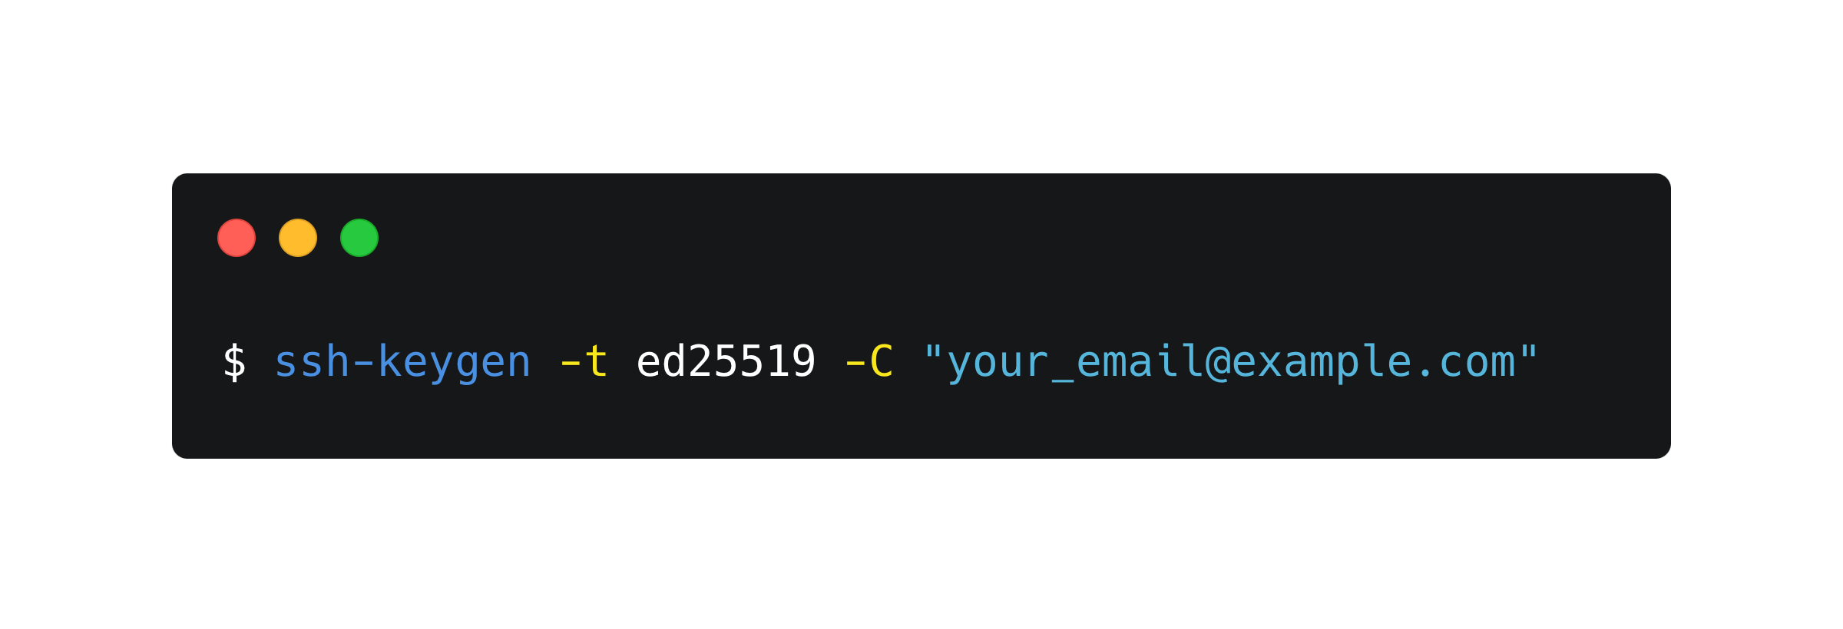

Slide 24
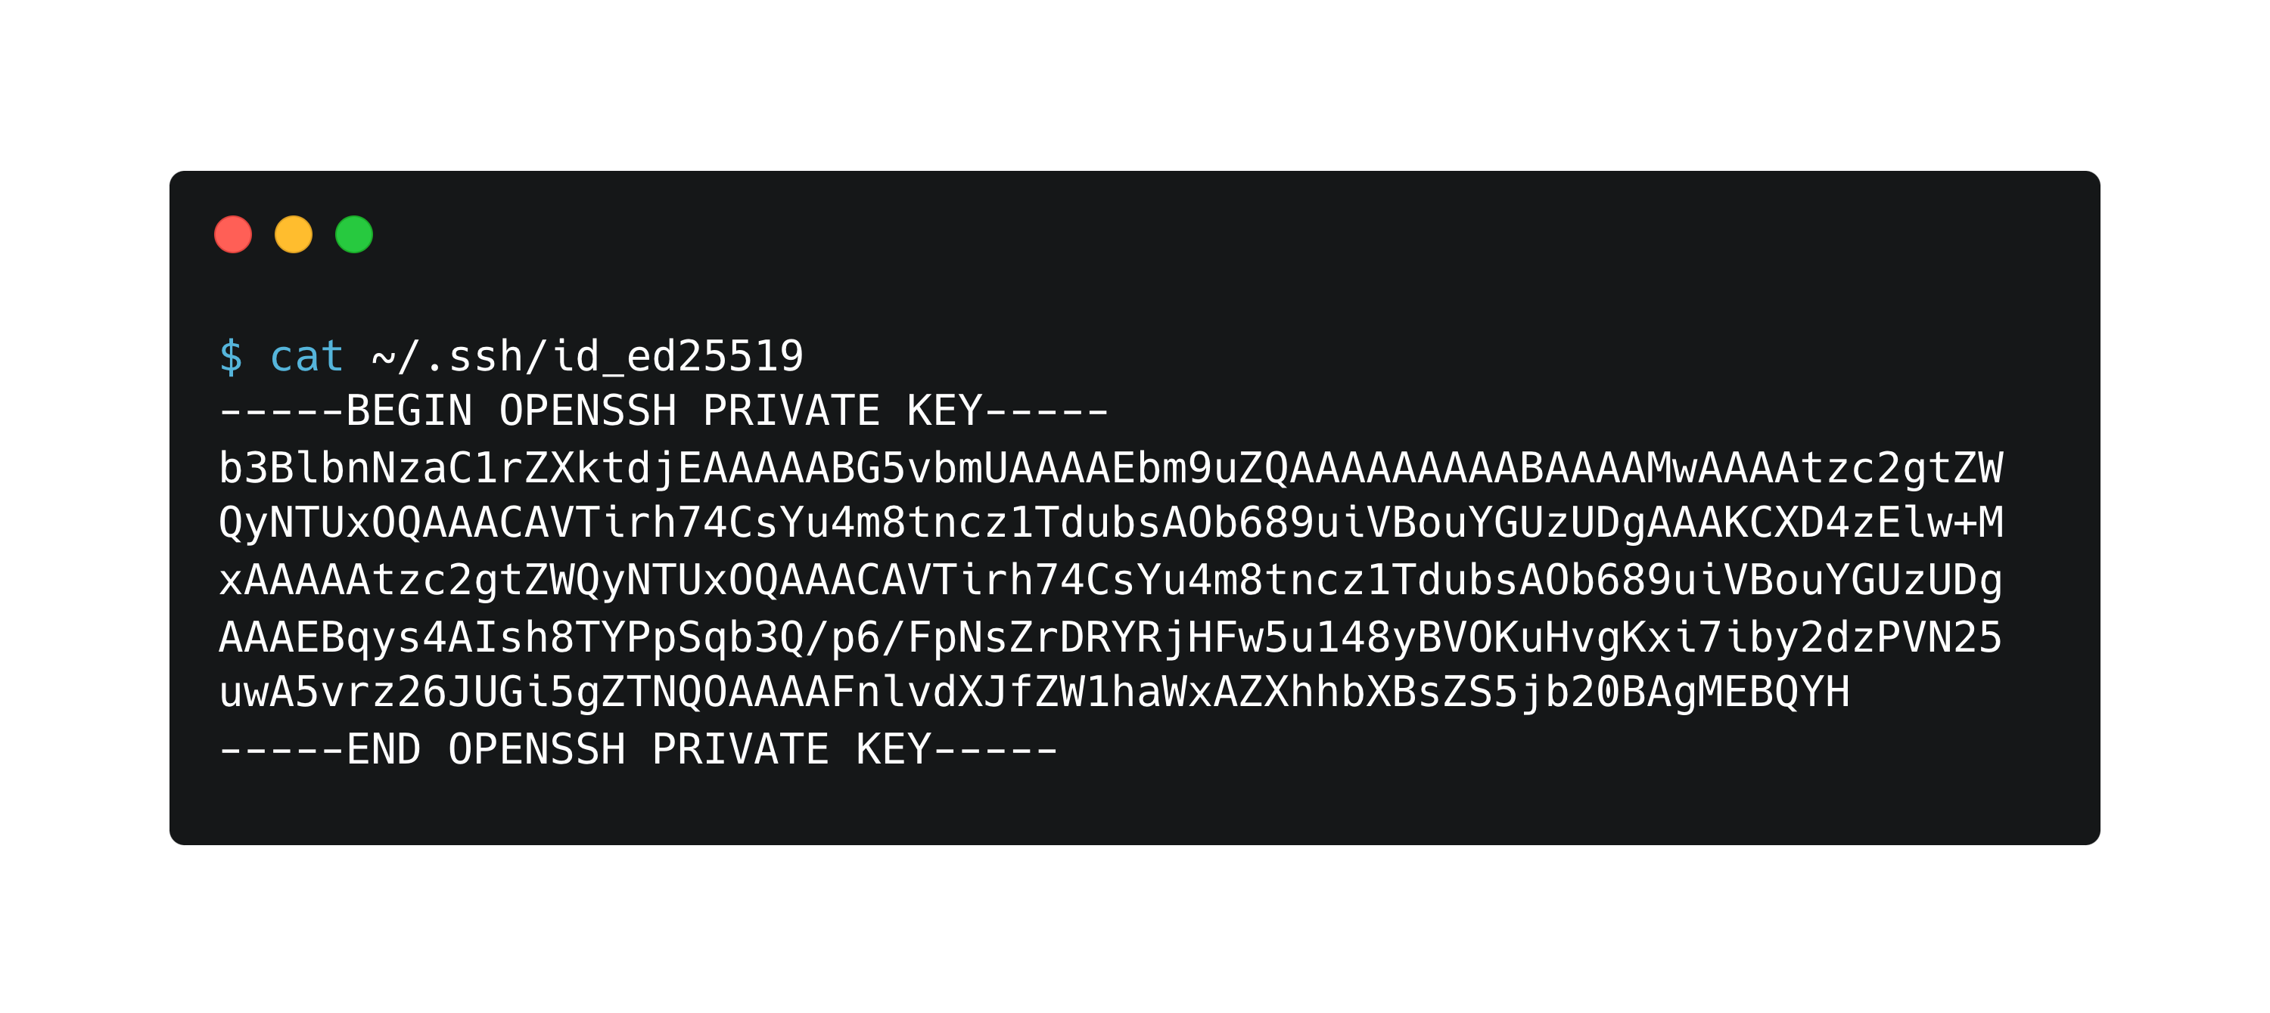

Slide 25
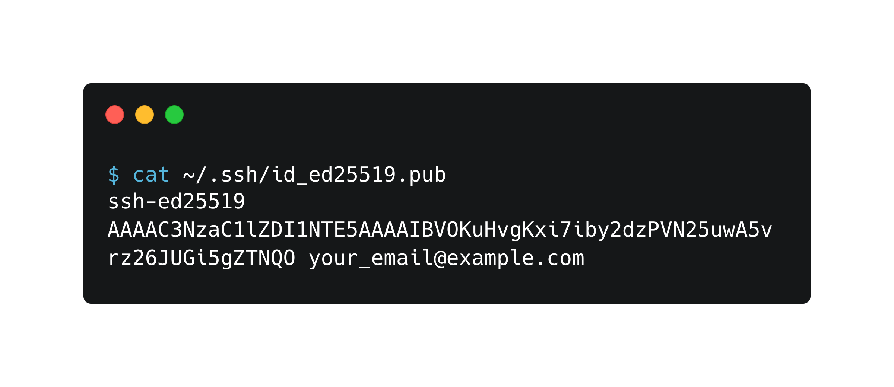

Slide 26

THANK YOU!

Slide 27
Citations
“Discover the Story of Englishmore than 600,000 Words, over a Thousand Years.” Home : Oxford English Dictionary, http://www.oed.com/.
“Difference between Symmetric and Asymmetric Key Encryption.” GeeksforGeeks, 18 Aug. 2022, https://www.geeksforgeeks.org/difference-between-symmetric-and-asymmetric-key-encryption/.
What Is Encryption? | Types of Encryption | Cloudflare. https://www.cloudflare.com/learning/ssl/what-is-encryption/.

